Slide 1
Generating Publicity for Your Club
Notes:
A brief presentation to bring some new ideas to how to market your club. Yes, market, rather than advertise. This requires you to shift how you look at your club; it's a product; a brand.

Slide 2
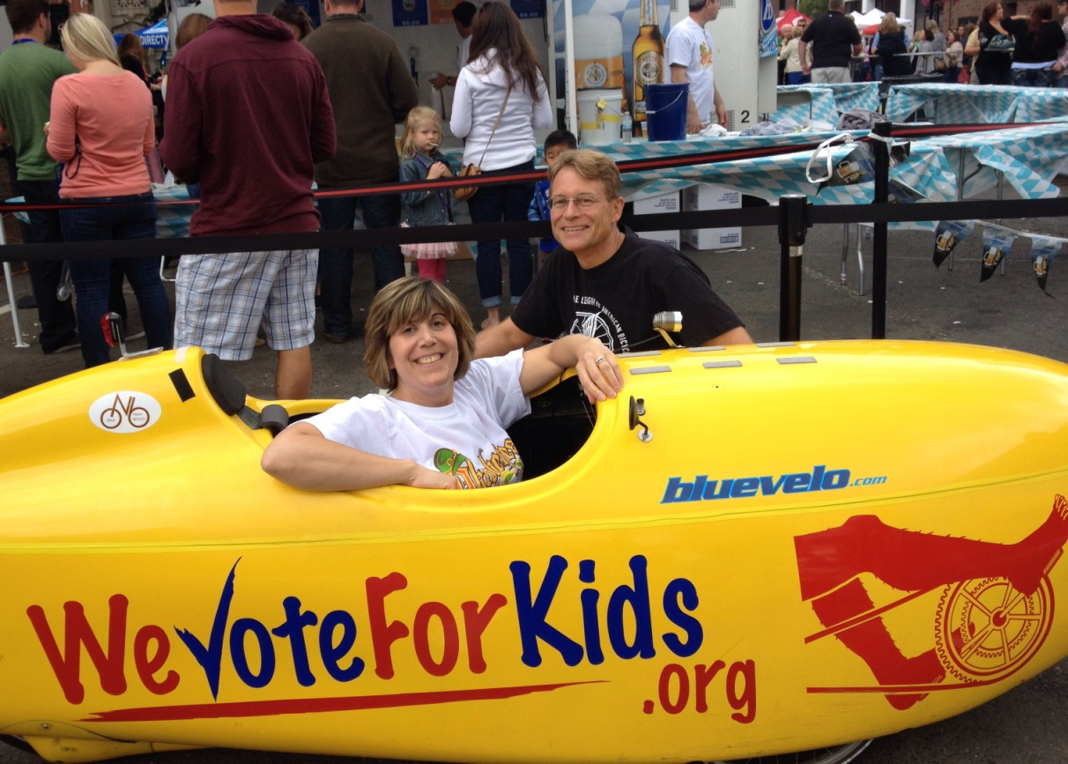
Why Publicize?
Increase Public Support
Attract New Members
Serve More People
Motivate Members

Slide 3
The PR Process
Every Project:
Find your story
Make it newsworthy
Alert your publics well ahead of time
Pre-event is publicity; post-event is news
Notes:
A good press release starts the publicity ball rolling. It forces your club to find its story – articulate why the public should care. Don't submit more than one press release a week, and preferably, no more than once a month. Press releases can be written well in advance and embargoed, that is, with a given release date, or can be marked for immediate release.
Discuss rewritten release – Editorial style vs News (Emotions vs facts)

Slide 4
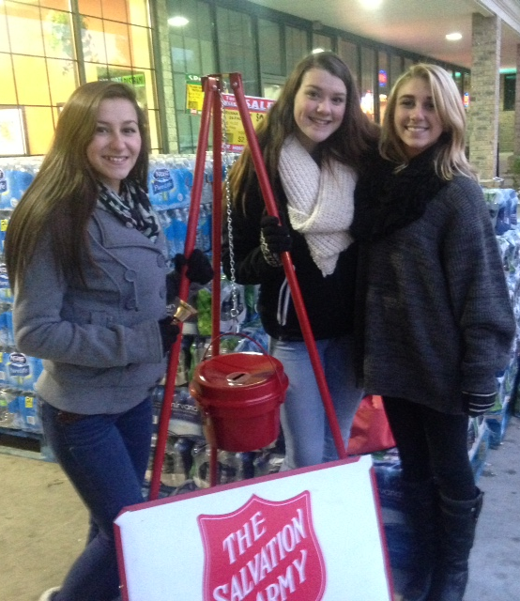
Find Your Audience
Local Community
Neighboring Cities and Towns
Special Interest Groups
Other Lions Clubs
Notes:
Who are they? What do they believe the community needs? Which other service organizations are communicating with them?

Slide 5
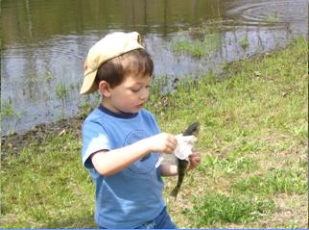
Publicity Involves Conversation
Your Lions
Your Publics
Notes:
Your club has more than one “public”. You should be prepared to communicate with each one. There may be overlap in communication style and method. But knowing who your “publics” are can make an enormous difference in the success of your publicity efforts.

Slide 6
How Do You Talk to Each Public?
School /Day Care
Parents
Grandparents
Restaurants/Co-sponsors
Trinkets
Playful Child

Slide 7
How Do You Talk to Each Public?
Lawn Signs
Online Ads
Facebook Events
Flyers
Supermarket Info Tables
Busy Mom

Slide 8
How Do You Talk to Each Public?
Lawn Signs
Newsletters
Mailers
TV
Newspapers
Supermarket Info Tables
Reluctant Granma

Slide 9
How Do You Talk to Each Public?
Lawn Signs
Online Ads
Facebook Events
Email Campaigns
Trinkets
Restaurants/Co-sponsors
Supermarket Info Tables

Slide 10
Sometimes You Can’t Talk Directly
Media
Family
Friends

Slide 11
Step 1: The Press Release
Stick to the topic – be concise
Make it read like a news story (look at an article in a target publication)
“We are the greatest” doesn’t work
Get quotes from recognizable personalities – they lend credibility to your release
Notes:
A lot of news stories in the paper are actually well-written press releases. Local newspapers love them because it's less work for them. Get the main point across in the first two paragraphs because if it gets cut down, they tend to chop the middle out. Don't submit more than one press release a week, and preferably, no more than once a month. Press releases can be written well in advance and embargoed, that is, with a given release date, or can be marked for immediate release.
Discuss rewritten release – Editorial style vs News (Emotions vs facts)

Slide 12
The Press Release (continued)
Most Important WHY
START
Least Important DETAILS
FINISH
Notes:
A lot of news stories in the paper are actually well-written press releases. Local newspapers love them because it's less work for them. Get the main point across in the first two paragraphs because if it gets cut down, they tend to chop the middle out. Don't submit more than one press release a week, and preferably, no more than once a month. Press releases can be written well in advance and embargoed, that is, with a given release date, or can be marked for immediate release.
Discuss rewritten release – Editorial style vs News (Emotions vs facts)

Slide 13
The Press Release (continued)
Strong opening sentence: The Five "W"s
Why is most important
Tell them; tell them again; and again!
Boilerplate – Background on your club, your event, etc.
PHOTOS!!!!
Notes:
A lot of news stories in the paper are actually well-written press releases. Local newspapers love them because it's less work for them. Get the main point across in the first two paragraphs because if it gets cut down, they tend to chop the middle out. Don't submit more than one press release a week, and preferably, no more than once a month. Press releases can be written well in advance and embargoed, that is, with a given release date, or can be marked for immediate release.
Discuss rewritten release – Editorial style vs News (Emotions vs facts)

Slide 14
Make It Look Professional
Letterhead, where applicable
US Mail or delivery service
Use email, if they allow it
Address to a specific person
Proofread - No Type-Os!
Notes:
The media gets hundreds, if not thousands, of requests each month. You need to make yours stand out. A handwritten letter will be ignored. A "To Whom It May Concern" letter gets trashed. Do homework and find out who the contact is. Personalize correspondence. Print CD labels instead of writing with marker. Same with mailing labels. Return address labels with logo.
The secret is, if you do a professional job, then the professionals will see you as one of them:part of the "inner circle".
Incremental costs are minor, if you get a big bang for the buck.

Slide 15
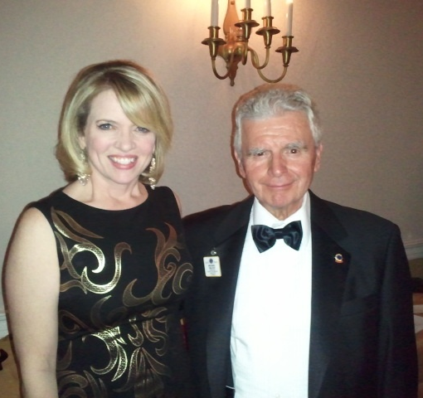
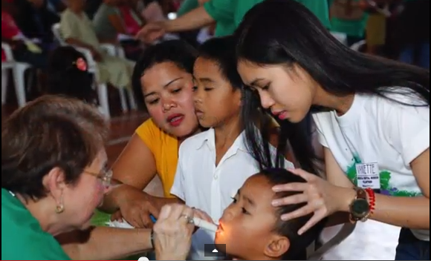
Step 2: Find Photos
Photos tell stories – if they’re clear!
Will it matter to the audience?
Notes:
Dr. McClennan article. Written as a press release. (in packet).
Haunted Hayride articles. Written by reporter Got us 2 additional weeks of publicity before the event, plus, another article (written by me) for a magazine.

Slide 16
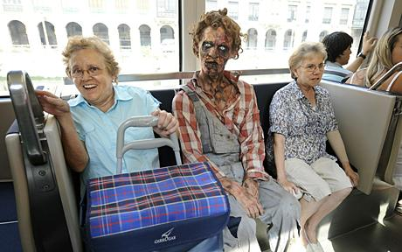
Photos (continued)
Make it memorable
Notes:
Dr. McClennan article. Written as a press release. (in packet).
Haunted Hayride articles. Written by reporter Got us 2 additional weeks of publicity before the event, plus, another article (written by me) for a magazine.

Slide 17
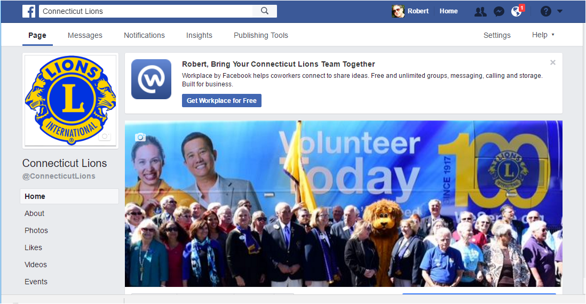
Step 3: Create a Facebook Post
Lions bring free health care to the Philippines.
Notes:
Let's look at the tools we have at our disposal to The trick to a good poster is that it's eye-catching. Good use of "white space" with a dominant image will draw the eye to it. Don't clutter it with too much information.
Consider a poster hung at the supermarket – how many people will see it during the day – and how often will they see it (repeat exposure). Proper placement is important – you can pick where you'd like it displayed, instead of a shotgun approach, hoping the right people will see it.
. .

Slide 18
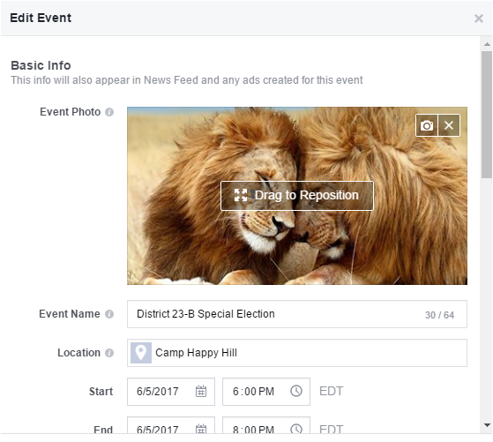
Step 4: Create a Facebook Event
Support free health care in the Philippines.

Slide 19
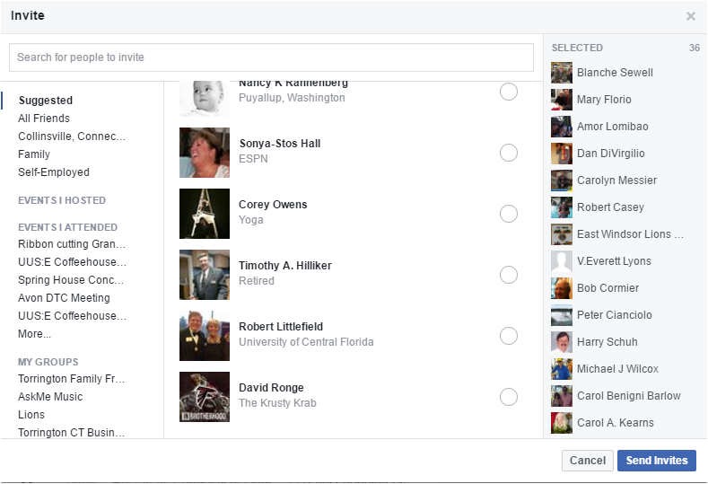
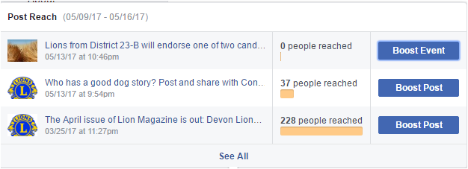
Step 4: Invite People to Your Event

Slide 20
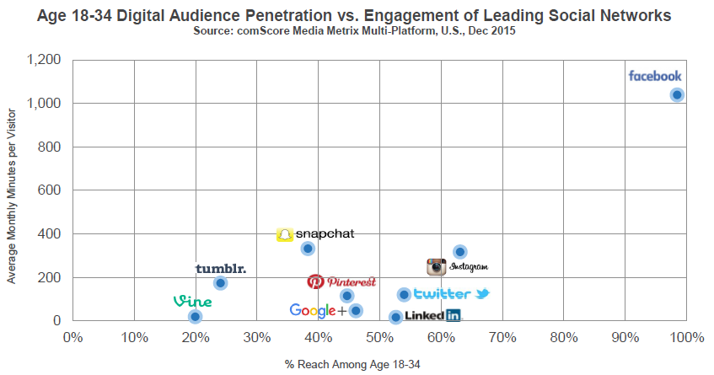
Facebook usage accounts for 1 in every 6 minutes spent online
...and more than 1 in 5 minutes spent on mobile!

Slide 21
Step 5: Posters
Low-cost
Wide exposure
Repeat exposure
Targeted placement
Gateway to more information
Notes:
Let's look at the tools we have at our disposal to The trick to a good poster is that it's eye-catching. Good use of "white space" with a dominant image will draw the eye to it. Don't clutter it with too much information.
Consider a poster hung at the supermarket – how many people will see it during the day – and how often will they see it (repeat exposure). Proper placement is important – you can pick where you'd like it displayed, instead of a shotgun approach, hoping the right people will see it.
. .

Slide 22
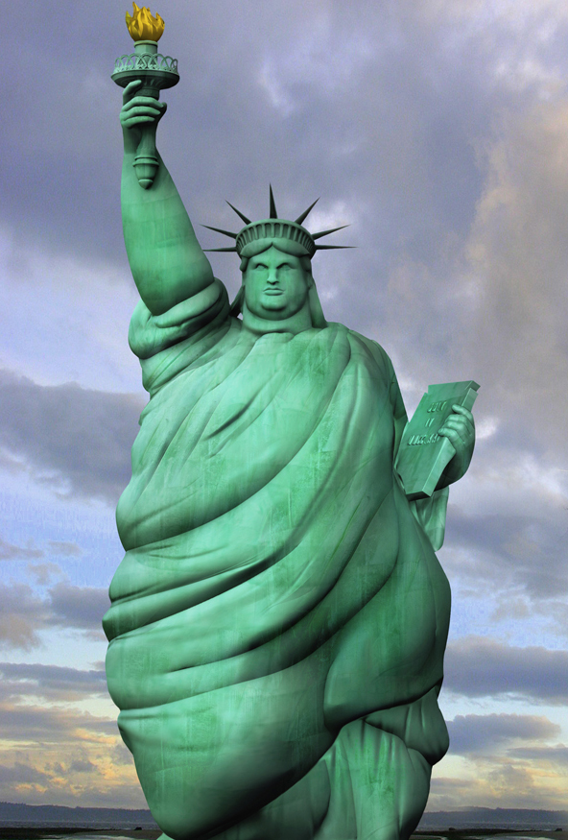
Poster Design Guidelines
Find your focus
See it instantly
Balance layout
50% whitespace
Use color wisely
Pick one font
START
YOUR
DIET!
Notes:
Only the most important information but point to where they can get more information
Use whole space, but don't crowd.
Complementary Colors – color wheel
No comic sans!

Slide 23
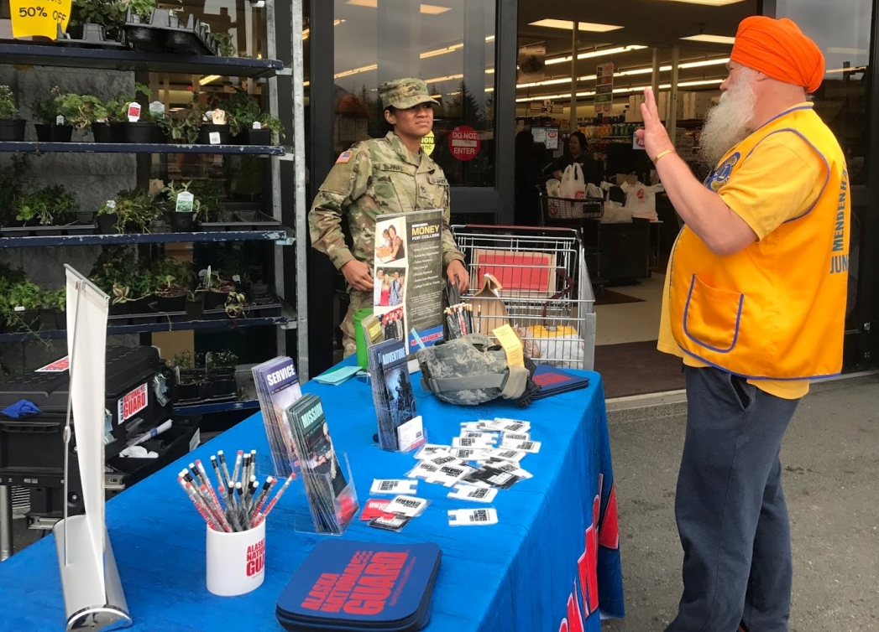
Step 6: Supermarket Info Tables
Show your poster
Tell them your story
Have info available about your club
Smile!
Notes:
Dr. McClennan article. Written as a press release. (in packet).
Haunted Hayride articles. Written by reporter Got us 2 additional weeks of publicity before the event, plus, another article (written by me) for a magazine.

Slide 24
Step 7: Lawn Signs
Much more expensive than posters
Use a few LARGE words
Design to be reusable
Location, location, location
SCARED?
YOU WILL BE!
Notes:
My printer can produce 11x17 posters for about $1 each. 18X24 lawn signs, in 100 quantity for about $10 each. Dates/prices should be able to be modified. Individual stickers to cover, same colors as background/foreground Put where your target audience can see them.
Smaller signs need slower roads, and nearer to street (show vote sign).
18x24 sign best below 25mph

Slide 25
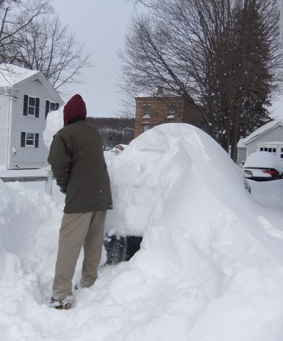
Step 8: Feature Articles
Focus on one detail
Human interest
Sell the story
Post to Facebook
Look for response
Notes:
Dr. McClennan article. Written as a press release. (in packet).
Haunted Hayride articles. Written by reporter Got us 2 additional weeks of publicity before the event, plus, another article (written by me) for a magazine.

Slide 26
Step 9: Paid Advertising
Use only if needed
Ask about non-profit rates
Ask about multiple-insertion discounts
Find the right size ad
Make the ad eye-catching
Do you really need color?
Find someone else to pay for it
Notes:
If you're bringing people to your site via QR code, you want them to land on the page that has the information. It should also be readable by many devices.
Find people interested by having them sign-up for updates, or respond online – don't put email address on site – invites spam!
Log visitors -where from, what type of device they are using (by browser type) – can filter out spiders that bump up page hit count

Slide 27
Paid Advertising
Make it stand out
Good by itself
Lost with others
Notes:
We use paid ads sparingly. We place ads in the local papers that print our press releases. We place ads in papers that are outside the normal interest area for fund raisers. We eliminated ad placement in media where it did no good. For example, we were spending $500/yr to place ads in car magazines for our car show. I asked those magazines for subscriber and stand-sales counts to learn that we were only hitting about 1000 people, at best.

Slide 28
Internet Presence
Website – a constant
Should be Smart Phone compatible
Must be easy to update
Mailing list sign-up
Contact Us page
Club Phone Number
Club Email Address
Should not change every year!
Visitor logging
Notes:
If you're bringing people to your site via QR code, you want them to land on the page that has the information. It should also be readable by many devices.
Find people interested by having them sign-up for updates, or respond online – don't put email address on site – invites spam!
Log visitors -where from, what type of device they are using (by browser type) – can filter out spiders that bump up page hit count

Slide 29
Internet Presence
Website
Editing Tools provide templates for easy updates
Squarespace
Weebly
eClubhouse
Etc.
Compare your site with others – your audience will!
Notes:
If you're bringing people to your site via QR code, you want them to land on the page that has the information. It should also be readable by many devices.
Find people interested by having them sign-up for updates, or respond online – don't put email address on site – invites spam!
Log visitors -where from, what type of device they are using (by browser type) – can filter out spiders that bump up page hit count

Slide 30
Internet Presence
Twitter
Attract followers
Add Twitter widget to website
MUST tweet often –
Don’t be another “Twitter Death”
Place #hashtag on posters/other advertising
Notes:
With more smart devices, more people use twitter constantly. This is a good way to keep followers updated as you come to major milestones – remember, 140 characters including hashtags. Check hashtag beforehand to make sure that no one else is using it. .

Slide 31
Get the Right Message Across
One approach won't work for everyone
Review your present mailing list
Identify who belongs to which core groups
Generate 'hook' for each group
Produce versions of your club’s newsletter for each group
Notes:
Each of the groups on the last slide need a different approach. For example, start with a thank you for past donors and fund raiser supporters. You need to explain the need for support to potential donors and corporate sponsors. Special interest groups need to have explained to them why their support is in their interest.
85%-90% will be the same for everyone – usually the opening and closing are tweeked for different groups.

Slide 32
Your Publicity Plan
6 Weeks Ahead | Write Press Release Find Photos
4 Weeks Ahead | Add to Website Post on Facebook Send out Press Releases
3 Weeks Ahead | Hang Posters Start Supermarket Outreach
2 Weeks Ahead | Put out Lawn Signs
Notes:
Again, you need to start working on these well ahead of the event in order to get these out in tie.
To keep costs low, pick a 2 color design. Don't forget your QR code. Send copy out for bids. Wide range of prices, depending on the company's equipment
Also, an 8 1/2x11 format is more easily placed than an 11x17 – just because it's larger doesn't mean it can be read more easily, and a lot of places are more receptive to smaller signs. Taking down the signs immediately after the event makes it easier to put signs up next time. Perception- people HATE stale advertising.
Lawn signs – expensive ($20+ each), but easily mistaken for lawn care/painters/etc. Signboards are easier to recognize, but more expensive. 2 wk rule in Woodbury.

Slide 33
Define Your Goal
More People Served
More Donations
More Members
Fewer ‘Drops’
Fewer “Huh?” Responses
Notes:
Lots of overlap

