Slide 1
Effective Community Relations
Lions Bob Bessel and Frank Longo

Slide 2
“Ask not what your community can do for you. Ask what you can do for your community”

Slide 3
Biggest Mistakes in Community Relations
Only promoting your fundraisers
Relying too heavily on the Lion Brand
Not being a good social neighbor
Ignoring the power players in your community
Notes:
Who has coffee with the mayor in the morning? They have his/her ear; sell them, they sell mayor.

Slide 4
Get to Know Your Community Leaders
Local Government
Government Infrastructure
Other Civic Groups
Influential Business Leaders
Notes:
Politicians come and go – the real pulse of the community are the different department heads that make the community function.

Slide 5
Give Your Community Leaders Good Reasons to Know You
Attend their Meetings
Support their Activities
Look for Opportunities to Work Together
Collaborate on Projects
Become Known as “Go To” People
Get Caught Having Fun!
Notes:
Stop, listen, Collaborate! Ask them to join your club!

Slide 6
Open Channels of Communications
Newsletter
Attend Public Meetings
Invite Other Groups to Your Club Meetings
Have Informal Meetings…Coffee!
Be Available, Informed, Flexible
Contribute Your Expertise and Service

Slide 7
Understand How Your Audiences Communicate
No single media works for everybody!
Seniors
DNKs
Young Parents
Newlyweds
Young Adults

Slide 8
What's Missing in Your Community?
Community Needs Assessment
Mail the form?
Use it to guide in-person conversation
Letters to the Editor
Blog
Facebook & Linkedin Posts
Suggest Solutions
Excellent Execution

Slide 9
Devise a Strategic Plan
What?
Why?
Who?
How?
When?
Strengths
Weaknesses
Opportunities
Threats
Fresh Ideas!

Slide 10
Tactics
Manage the Media
Who are your anchors, editors and reporters?
What stories do they like to write and produce?
How will your story fit their media?
Enlist Support
Make it easy to accept your materials
Follow Through (or Explain Why)

Slide 11
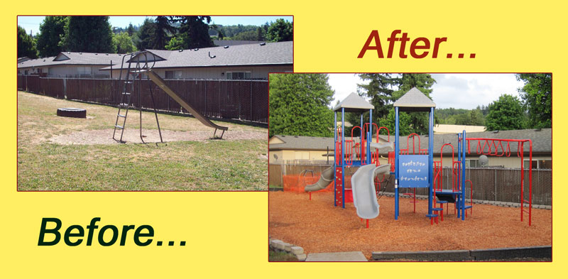
Promote the Results
Before/After Pictures
Don't Hog the Credit
Let others shine…they reflect well on you
Stepping Stone to Next Steps
Prove your relevance every time (today’s public is skeptical)

Slide 12
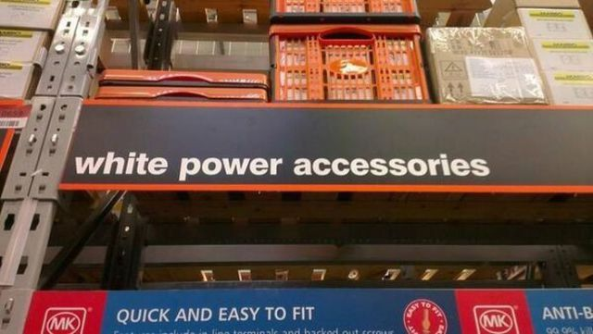
Beware Unintended Consequences
Spiraling/Conflicting Goals
Accidental Endorsement
Inadvertent Advertising
Sending the wrong message
Notes:
Context is everything! Partner with groups with similar goals, not opposing ones; set limits; Make sure that your partners intent meets the criteria of service, not using you to provide a service they would otherwise pay for. Avoid tie-ins with purely commercial ventures.

Slide 13
Respond to Detractors
Don’t ignore
Reply, don’t react
Stay unemotional
Fight with facts
Admit mistakes
Don’t hide behind the brand
Notes:
Context – a bad Twitter or Facebook comment is negligible. A bad comment in a newspaper article should be managed.

Slide 14
Celebrate Your Community
Show Your Enthusiasm
Infect Others
Be the Cheerleader, the Pollyanna, the Irrepressible Optimist
If Not You, Then Someone Else!

Slide 15
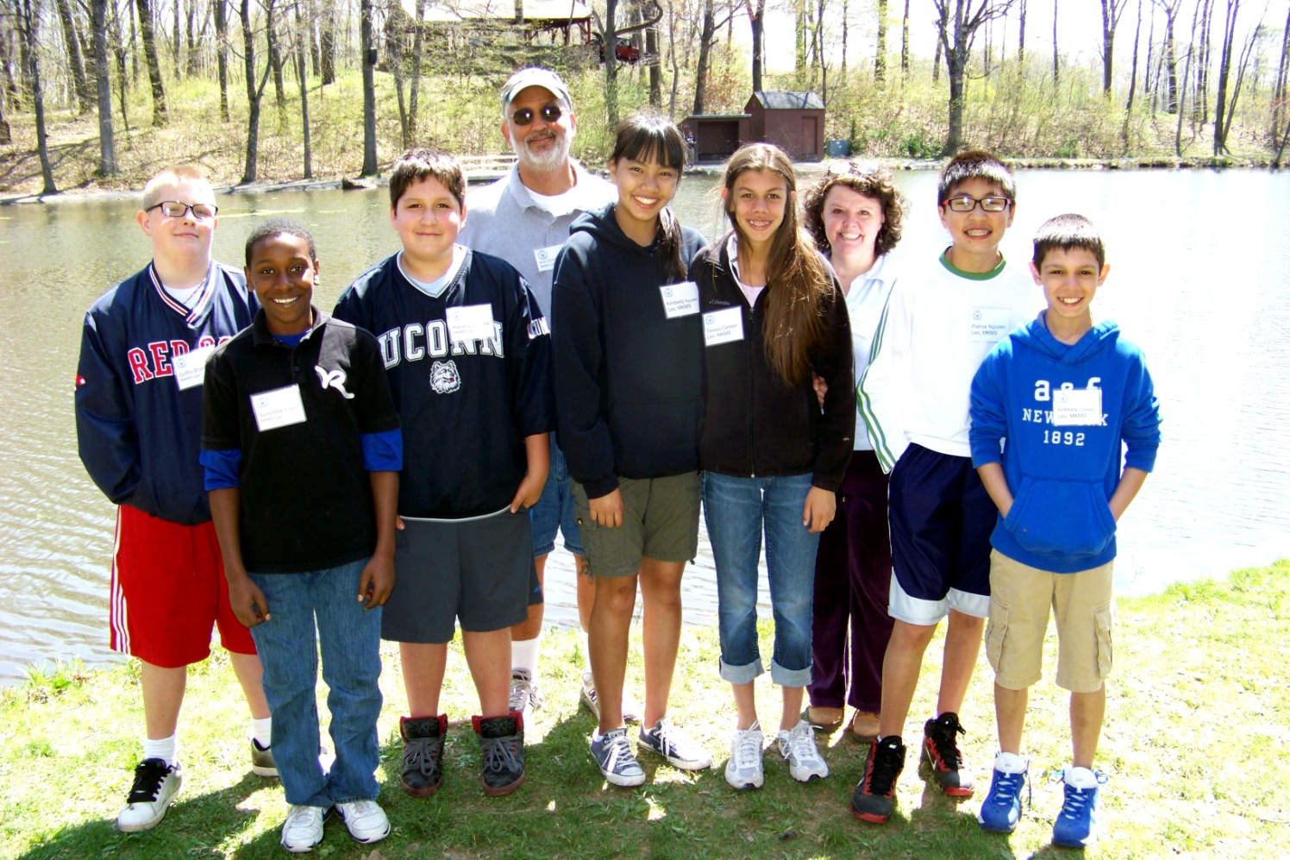
Everyone’s Looking for the Life of the Party
Let it be you!

